Slide 1
Variance Analysis – A Tool for Cost Control & Performance Evaluation

Slide 2
Introduction
Control decisions include questions of how to evaluate performance, what measures to use, and what types of incentives to use.
Managers can use the budget as a control tool by comparing budgeted sales, budgeted production, and budgeted manufacturing costs with actual sales, production, and manufacturing costs.
These comparisons are typically made through a process called variance analysis.
Notes:
Control decisions include questions of how to evaluate performance, what measures to use, and what types of incentives to use. Managers can use the budget as a control tool by comparing budgeted sales, budgeted production, and budgeted manufacturing costs with actual sales, production, and manufacturing costs. These comparisons are typically made through a process called variance analysis.

Slide 3
Management By Exception
The key to effective variance analysis is management by exception.
Management by exception is the process of taking action only when actual results deviate significantly from planned.
Notes:
The key to effective variance analysis is management by exception. Management by exception is the process of taking action only when actual results deviate significantly from planned. Variance analysis allows managers to see whether sales, production, and manufacturing costs are higher or lower than planned and, more important, why actual sales, production, and costs differ from those budgeted.

Slide 4
Standard Cost
A budget for a single unit of a product or a service is known as its standard cost. Just as the cost of a product consists of three components—direct materials, direct labor, and manufacturing overhead —a standard cost will be developed for each component.
Notes:
To facilitate the use of flexible budgeting for control purposes, it is useful to examine the budget at a micro level rather than a macro level—that is, to develop a budget for a single unit of a product or a service rather than for the company as a whole. A budget for a single unit of a product or a service is known as its standard cost.

Slide 5
Standard Cost Components
There are two separate cost components for each part of a product cost:
A standard quantity or amount of materials, labor or overhead.
A standard or budgeted price of materials, labor or overhead.
Notes:
Each component consists of two separate standards—a standard quantity and a standard price. The standard quantity tells us the budgeted amount of materials, labor, and overhead in a product, whereas the standard price tells us the budgeted price of the materials, labor, or overhead for each unit (gallon, hour, and so on).

Slide 6
Setting Standards
Standards can be determined in a couple of ways.
Historical Data
Task Analysis
Notes:
Standards can be determined in a couple of ways. Management can analyze historical data or use task analysis to set standards.

Slide 7
Historical Data
For companies with a long history of producing the same product, historical data can be very useful in forecasting future prices and quantities. However, it must be used with caution, especially when changes in product design or manufacturing processes impact amounts and prices of materials, labor, and overhead.
Notes:
Management can analyze historical cost and production data to determine how much materials and labor were used in each unit of product and how much the materials and labor cost. For companies with a long history of producing the same product, historical data can be very useful in forecasting future prices and quantities. However, it must be used with caution, especially when changes in product design or manufacturing processes impact amounts and prices of materials, labor, and overhead.

Slide 8
Task Analysis
Task analysis examines the production process in detail, with an emphasis on determining what it should cost to produce a product, not what it cost last year.
The best approach is some combination of task analysis and historical cost analysis to determine standard costs.
Notes:
Task analysis examines the production process in detail, with an emphasis on determining what it should cost to produce a product, not what it cost last year. The best approach is some combination of task analysis and historical cost analysis to determine standard costs.

Slide 9
Ideal Versus Practical Standards
An ideal standard is one that is attained
only when near-perfect conditions are present.
An ideal standard assumes that every aspect of the production process, from purchasing through shipment, is at peak efficiency.
A practical standard should be attainable under normal, efficient operating conditions.
Practical standards take into consideration that machines break down
occasionally, waste occurs in materials, etc.
Most managers would agree that practical standards encourage employees to be more positive and productive.
Notes:
Because standard costs are used to evaluate performance, human behavior can influence how the standards are determined. An ideal standard is one that is attained only when near-perfect conditions are present. An ideal standard assumes that every aspect of the production process, from purchasing through shipment, is at peak efficiency. A practical standard should be attainable under normal, efficient operating conditions. Practical standards take into consideration that machines break down occasionally, that employees are not always perfect, and that waste in materials does occur. Most managers would agree that practical standards encourage employees to be more positive and productive.

Slide 10

The Use of Standards by Non manufacturing Organizations
The use of standard costing applies to merchandising and service organizations as well.
For example, managed health care companies have developed a standard
amount of time for doctors seeing patients for particular ailments.
Notes:
The use of standard costing applies to merchandising and service organizations as well. For example, managed health care companies have developed a standard amount of time for doctors seeing patients for particular ailments.

Slide 11
Flexible Budgeting with Standard Costs
Flexible Budgets Based on Standards Costs
These are the centerpiece of effective variance analysis.
Notes:
The concept of flexible budgeting is based on the actual volume of production rather than on the planned level of production. Flexible budgets based on standard costs are the centerpiece of effective variance analysis.

Slide 12
Flexible Budgeting with Standard Costs
Let’s look at an example of Corinne’s Country Rockers, a company that builds a high-quality rocking chair with a patented rocking mechanism.
Notes:
To illustrate the concept of flexible budgets, consider the case of Corinne’s Country Rockers. Corinne’s builds a high-quality rocking chair with a reputation for lasting a lifetime and also uses a unique (and patented) rocking mechanism.

Slide 13
Flexible Budgeting with Standard Costs
 | Standard Quantity | Standard Price | Standard Cost
Direct Materials | 20 linear ft. | Rs.100 per ft. | Rs.2,000
Direct Labor | 5 labor hrs. | Rs.600per hr. | 3,000
Variable Overhead | 5 labor hrs. | Rs.150per hr. | 750
Total Var. Product Costs |  |  | Rs.5,750
Variable Sell & Adm. Costs |  |  | 1,250
Total Variable Costs |  |  | Rs.7,000
Fixed Overhead (per quarter) |  |  | Rs.750,000
Fixed Sell & Adm. Costs |  |  | 900,000
Total Fixed Costs |  |  | 1,650,000

Slide 14
Flexible Budgeting with Standard Costs
Std. Price = Rs. 12500 each
Actual Price = Rs. 12400 each

Slide 15
Flexible Budget Variance and Its Components
The flexible budget variance is the difference between the flexible budget operating income and the actual operating income.
Notes:
The flexible budget variance is the difference between the flexible budget operating income and the actual operating income.

Slide 16
Flexible Budget Variance

Slide 17
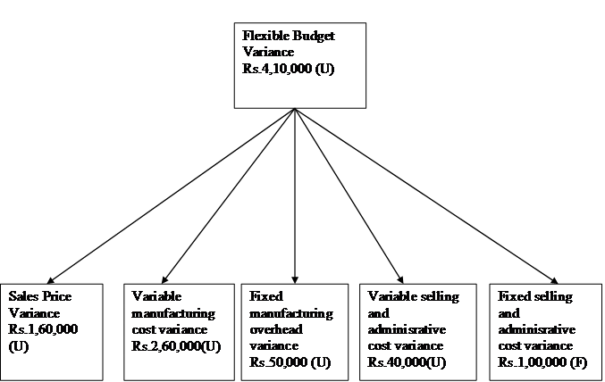
Flexible Budget Variance

Slide 18
Selling and Administrative Expense Variance
Variable selling and administrative costs include such things as commissions on sales, and administrative time to process each sale.
Fixed selling and administrative costs include the salaries of the sales manager and personnel manager and such facility costs as rent and insurance.
Selling and administrative variances are difficult to analyze and interpret.
Notes:
Variable selling and administrative costs include such things as commissions on sales, and administrative time to process each sale. Fixed selling and administrative costs include the salaries of the sales manager and personnel manager and such facility costs as rent and insurance. Selling and administrative variances are difficult to analyze and interpret.

Slide 19
Breaking Down the Variable Manufacturing Cost Variance
The flexible budget variance may show that actual variable manufacturing costs are higher than budgeted, but what is the true cause?
Spent too much on materials??
Spent more than budgeted on electricity or supplies??
Incurred more labor cost than usual??
Notes:
The flexible budget variance may show that actual variable manufacturing costs are higher than budgeted, but what is the true cause? In the case of Corrine, did the company spend too much on materials or use too much? Did the company incur more labor costs than usual, owing to paying a higher wage, or did it spend more time making each chair than budgeted? Did Corinne’s spend more than budgeted on electricity, supplies, and other variable overhead or use more than budgeted?

Slide 20
Variable Manufacturing Costs
Notes:
To analyze the variable cost variances based on a flexible budget, we must step back and examine the flexible budget in more detail. Even though Corinne’s actual expenditures for total variable production costs were greater than budgeted, Corinne’s spent slightly less than the amount budgeted for direct materials and variable overhead but much more for direct labor.

Slide 21
The Basic Variance Analysis Model
Price
variance = Actual X Actual - Standard
quantity (AQ) price (AP) price (SP)
[
]
Usage
variance = Standard X Actual - Standard
price (SP) quantity (AQ) quantity (SQ)
[
]
Notes:
The next step in variance analysis is to break down the direct material, direct labor, and variable overhead variances into their components (a price variance and a usage or quantity variance), using the basic variance analysis model.

Slide 22
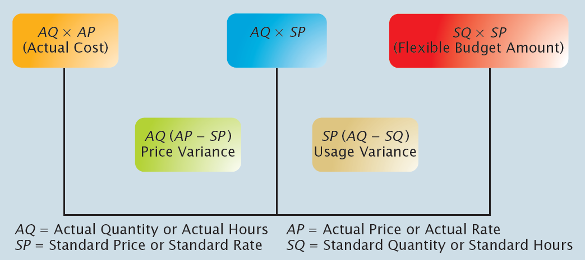
The Variance Analysis Model
Notes:
The price variance is simply the difference in price multiplied by the actual quantity. The usage variance is simply the difference in quantity multiplied by the standard price. The variance model separates the overall flexible budget variance into two components—one the result of paying more or less than budgeted and the other the result of using more or less than budgeted.

Slide 23
Direct Material Variances
Direct Material Variances are made up of both a price variance and a usage variance.
Notes:
Direct Material Variances are made up of both a price variance and a usage variance.

Slide 24
Direct Material Price Variance
The Direct Material Price Variance is calculated by multiplying the actual amount of material purchased by the difference in the actual price paid and the standard or budgeted price.
Notes:
The Direct Material Price Variance is calculated by multiplying the actual amount of material purchased by the difference in the actual price paid and the standard or budgeted price.

Slide 25
Direct Material Usage Variance
The Direct Material Usage Variance is found by multiplying the standard price by the difference in the actual quantity used and standard quantity allowed.
* When calculating the usage variance, remember that the standard quantity allowed is the amount of direct material that should have been used to produce the actual output (the flexible budget amount).
Notes:
The Direct Material Usage Variance is found by multiplying the standard price by the difference in the actual quantity used and standard quantity allowed. When calculating the usage variance, remember that the standard quantity allowed is the amount of direct material that should have been used to produce the actual output (the flexible budget amount).

Slide 26
Favorable Direct Material Price Variances
Favorable Direct Material Price Variances are caused by:
Purchase of low-quality materials
Negotiating reduced prices with suppliers
Taking Advantage of Unexpected Quantity Discounts
Notes:
Possible reasons for a favorable price variance include taking advantage of unexpected quantity discounts or negotiating reduced prices with suppliers. However, favorable direct material price variances can also result from the purchase of low-quality materials.

Slide 27
Unfavorable Direct Material Price Variances
Unfavorable Direct Material Price Variances are caused by:
Purchasing
Higher-Quality Materials Than Budgeted
Purchasing
in Small Lot Sizes
Rush Orders
Notes:
Unfavorable material price variances might result from rush orders (requiring faster delivery and higher prices), purchasing in small lot sizes (and not taking advantage of quantity discounts), and purchasing higher-quality materials than budgeted.

Slide 28
Favorable Direct Material Usage Variances
Favorable Direct Material Usage Variances are caused by:
Well-Maintained Machinery and
Equipment
Highly Efficient Workers
Notes:
Favorable material usage variances are likely a result of highly efficient workers and well-maintained machinery and equipment.

Slide 29
Unfavorable Direct Material Usage Variances
Unfavorable Direct Material Usage Variances are caused by:
More defective units caused by the use of low quality materials
Machine Breakdowns
Poorly Trained
Workers
Notes:
Unfavorable material usage variances can likewise be caused by a number of reasons—poorly trained workers, machine breakdowns, or perhaps even the use of low-quality materials if they result in more defective units, machine downtime, rework, and so on.

Slide 30
Direct Labor Variances
~
Direct labor variances are calculated using the same basic variance model used to
calculate direct material variances.
Higher wage rates result in unfavorable labor rate variances and favorable labor efficiency variances.
Lower wage rates result in
favorable labor rate variances and unfavorable labor efficiency variances.
Notes:
Direct labor variances are calculated using the same basic variance model used to calculate direct material variances. Higher wage rates result in unfavorable labor rate variances and favorable labor efficiency variances Lower wage rates result in favorable labor rate variances and unfavorable labor efficiency variances. The differences between favorable and unfavorable labor variances also reflect a number of significant trade-offs related to skill levels of employees.

Slide 31
Exhibit 12-10 from book

Slide 32
Example

Slide 33
ABC Ltd. makes and sells a single product. The company uses a
Standard marginal costing system. It plans to produce and sell 1000
units in May 2018. A budget statement is produced as follow:
Budgeted income statement for the month ended 31 May 2018
$ $
Sales ($50*1000) 50000
Less: Variable cost of goods sold
Direct materials ($3*4000) 12000
Direct labour ($5*3000) 15000
Variable overheads ($2*3000) 6000 33000
Budget contribution 17000
Fixed overhead 3000
Budget profit 14000

Slide 34
The actual sales and production is 800 units. The actual income
statement is shown as follows:
Income statement for the month ended 31 May 2018
$ $
Sales ($60*800) 48000
Less: Variable cost of goods sold
Direct materials ($3.2*2400) 12000
Direct labour ($6*3200) 15000
Actual Variable overheads 5500 32380
Contribution 15620
Fixed overhead 2600
Net profit 13020

Slide 35
Material cost variance
Material price variance
= (standard price – actual price)*actual quantity
= ($3 - $3.2)*2400
= $480 (A)
Material usage variance
= (Standard quantity – actual quantity)* standard price
= (Standard quantity for actual production – actual quantity production) * standard price
= (4*800 – 2400)*$3
= $2400 (F)
4000 units
1000 units

Slide 36
Material cost variance
Material price variance $480 (A)
Material usage variance $2400 (F)
Total Material cost variance $1920 (F)

Slide 37
Labour cost variance
Labour rate variance
= (standard price – actual price)*actual quantity
= ($5 - $6)*3200
= $3200 (A)
Labour efficiency variance
= (standard quantity – actual quantity)*standard price
= Standard quantity for actual production – actual quantity used) * standard price
= (3* 800 – 3200)*$5
= $4000 (A)
3000 units
1000 units

Slide 38
Labour cost variance
Labour rate variance $3200 (A)
Labour efficiency variance $4000 (A)
Total labour cost variance $7200 (A)

Slide 39
Variable Overhead Variances
With slight modifications, we can calculate variable overhead variances using the
same variance model as for direct material and direct labor variances.
The price variance is often called a variable overhead spending variance and, like
the labor usage variance, the usage variance for variable overhead is called an efficiency variance.
Notes:
With slight modifications, we can calculate variable overhead variances using the same variance model as for direct material and direct labor variances. The price variance is often called a variable overhead spending variance and, like the labor usage variance, the usage variance for variable overhead is called an efficiency variance.

Slide 41
Fixed Overhead Variances
Fixed overhead variances consist of: (1) a budget variance and (2) a volume variance.
(1) The budget variance (or spending variance) is simply the difference between the
amount of fixed overhead actually incurred and the flexible budget amount.
(2) The volume variance is the difference between the flexible budget amount and the amount of fixed overhead applied to products.
Notes:
Fixed overhead variances consist of: (1) a budget variance and (2) a volume variance. The budget variance (or spending variance) is simply the difference between the amount of fixed overhead actually incurred and the flexible budget amount. The volume variance is the difference between the flexible budget amount and the amount of fixed overhead applied to products.

Slide 42
Sales Variance
Sales Revenue Variance: the difference between actual sales revenue and the budgeted sales revenue.
Sales Price Variance
Sales
Price = (Actual – Budgeted Sales Price) x Actual
Variance Volume

Slide 43
Sales Variance
Sales Volume Variance:
Sales
Volume = (Actual – Expected Volume) x Budgeted
Variance Price

Slide 44
Profit Variances

